Slide 1

Fitness Club Membership Management
A comprehensive relational database system for modern fitness clubs.

Slide 2



Introduction: Project Overview
Relational Database System
Key Features
Includes schema design, ER modeling, SQL implementation, advanced queries, and data protection.
This project implements a robust relational database for fitness club management.
PostgreSQL Powered
Utilizes PostgreSQL as the powerful and reliable database engine.

Slide 3


System Overview: What We Manage
Members & Plans
Information on members and their chosen membership plans.
Classes & Schedules
Details on classes, schedules, and attendance records.
Payments & Subscriptions
Tracking of all payments and active subscriptions.
Trainers & Lockers
Management of trainers and locker assignments.

Slide 4
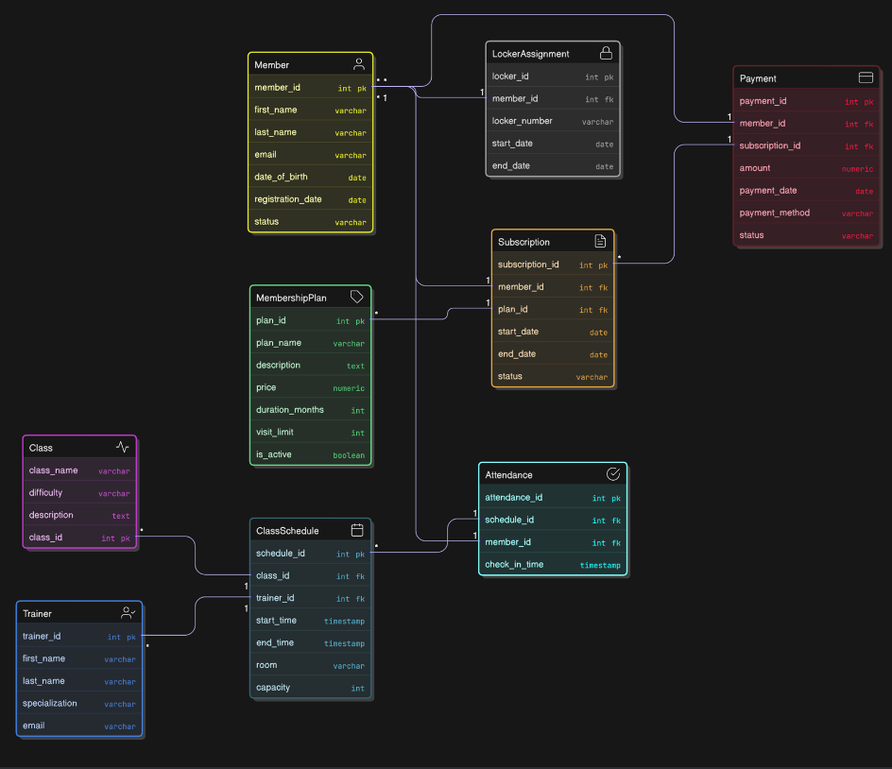
ER Model:
Core Entities

Slide 5





Key Relationships
Member – Subscription (1:N)
One member can have multiple subscriptions over time.
MembershipPlan – Subscription (1:N)
A plan can be associated with many subscriptions.
Trainer – ClassSchedule (1:N)
One trainer can lead multiple class schedules.
Member – Attendance (1:N)
A member can have many attendance records.
Member – LockerAssignment (1:1)
Each member has one locker assignment.

Slide 6



Database Implementation: PostgreSQL
1
Schema Creation
Defined tables with primary and foreign keys.
2
Constraints
Implemented CHECK and UNIQUE constraints for data integrity.
3
Cascading Rules
Ensured data consistency with cascading updates/deletes.
4
Normalized Structure
Designed for efficiency and reduced data redundancy.

Slide 7
SQL Queries: Data Interaction
Basic Queries
Selection and filtering
Efficient data joins
Advanced Analytical Queries
Common Table Expressions (CTE)
Window functions for complex analysis
Aggregate functions for summaries

Slide 8

Transactions & Indexing
Multi-step Transactions
COMMIT / ROLLBACK
Performance Indexes
Ensuring data integrity across multiple operations.
Controlling data changes with atomic operations.
Optimizing query speed for large datasets.

Slide 9
Views & Functions: Reusability
Reusable Views
Simplified data access for reporting
Streamlined analytics processes
SQL & PL/pgSQL Functions
Encapsulated complex logic
Improved code modularity and efficiency

Slide 10




Conclusion: A Complete Solution
Schema Design
Advanced Querying
Well-structured and normalized database.
Powerful data retrieval and analysis.
Optimization
Data Protection
Transactions and indexing for peak performance.
Robust backup and recovery strategies.

